Slide 1


Department of BES-1
DaTA STRUCTUREs Through python
24sc1204
Topic:
Prim’s Minimum Spanning Tree (MST)
Session - 38

Slide 2



AIM OF THE SESSION
To familiarize students with the concept of Prim’s minimum Spanning Tree.
INSTRUCTIONAL OBJECTIVES
This Session is designed to:
Demonstrate :- Minimum Spanning tree and its type.
Describe :- Prim’s Algorithm and calculating MST using Prim’s algorithm.
LEARNING OUTCOMES
At the end of this session, you should be able to:
Define :- Minimum Spanning tree and its types
Describe :- Prim’s Algorithm
Summarize:- How to calculate MST with Prim’s Algorithm.

Slide 3
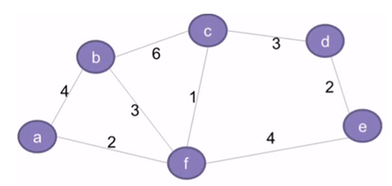
SESSION INTRODUCTION
Minimum spanning tree
A minimum spanning tree (MST) is a spanning tree that has a weight that is equal to or less than all of the other spanning trees in a weighted, connected, undirected graph.

Slide 4
SESSION DESCRIPTION (Cont..)
Algorithm
1) Create a set mstSet that keeps track of vertices already included in MST.
2) Assign a key value to all vertices in the input graph. Initialize all key values as INFINITE. Assign key value as 0 for the first vertex so that it is picked first.
3) While mstSet doesn’t include all vertices
----Pick a vertex u which is not there in mstSet and has minimum key value.
----Include u to mstSet.
----Update key value of all adjacent vertices of u. To update the key values, iterate through all adjacent vertices. For every adjacent vertex v, if weight of edge u-v is less than the previous key value of v, update the key value as weight of u-v

Slide 5
SESSION DESCRIPTION (Cont..)
The idea of using key values is to pick the minimum weight edge from cut.
The key values are used only for vertices which are not yet included in MST, the key value for these vertices indicate the minimum weight edges connecting them to the set of vertices included in MST.

Slide 6
SESSION DESCRIPTION (Cont..)
Prim’s algorithm
Kruskal’s algorithm
Applications
Used to construct trees for broadcasting in computer networks.
Used in graph-based cluster analysis.
Used in image segmentation.
Used in regionalisation of socio-geographic areas, where regions are grouped into contiguous regions.

Slide 7
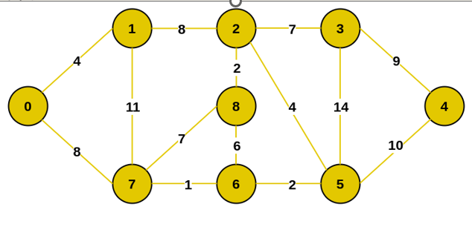
Prim’s Algorithm (Example)
Let us understand with the following example:

Slide 8
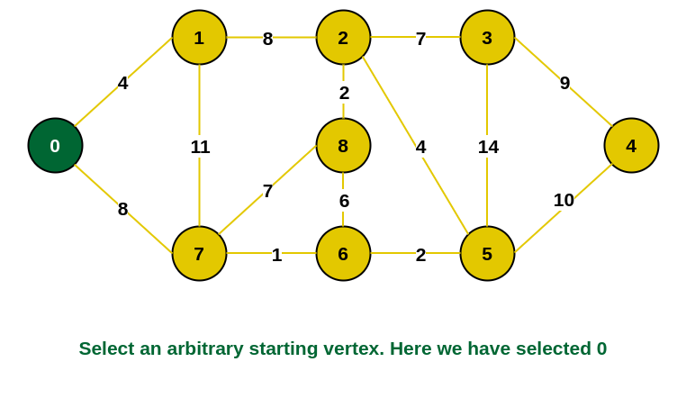
Prim’s Algorithm (Example conti..)
Step 1: Firstly, we select an arbitrary vertex that acts as the starting vertex of the
Minimum Spanning Tree. Here we have selected vertex 0 as the starting vertex.

Slide 9
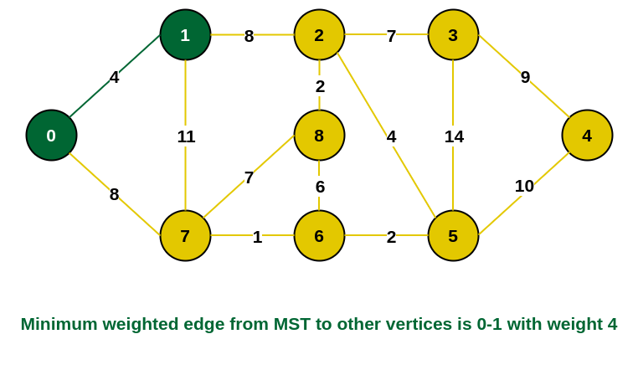
Prim’s Algorithm (Example conti..)
Step 2: All the edges connecting the incomplete MST and other vertices are
the edges {0, 1} and {0, 7}. Between these two the edge with minimum
weight is {0, 1}. So include the edge and vertex 1 in the MST.

Slide 10
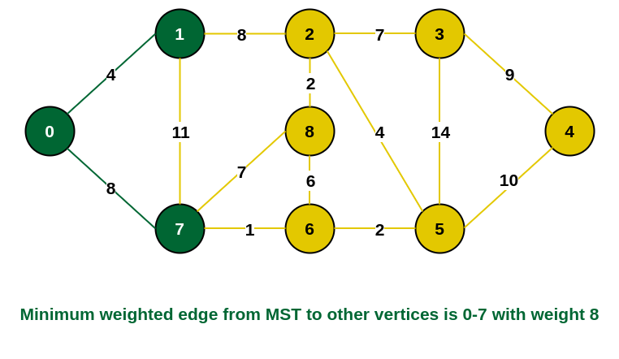
Prim’s Algorithm (Example conti..)
Step 3: The edges connecting the incomplete MST to other vertices are {0, 7}, {1, 7}
and {1, 2}. Among these edges the minimum weight is 8 which is of the edges {0, 7}
and {1, 2}. Let us here include the edge {0, 7} and the vertex 7 in the MST. [We could
have also included edge {1, 2} and vertex 2 in the MST].

Slide 11
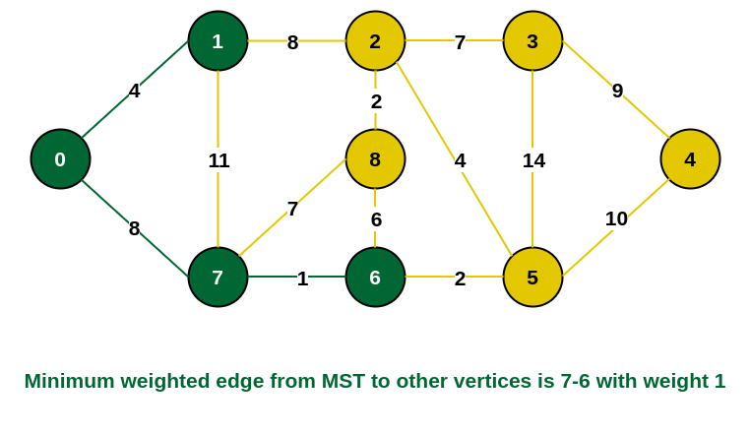
Prim’s Algorithm (Example conti..)
Step 4: The edges that connect the incomplete MST with the fringe vertices are {1, 2}, {7, 6} and {7, 8}. Add the edge {7, 6} and the vertex 6 in the MST as it has the least weight (i.e., 1).

Slide 12
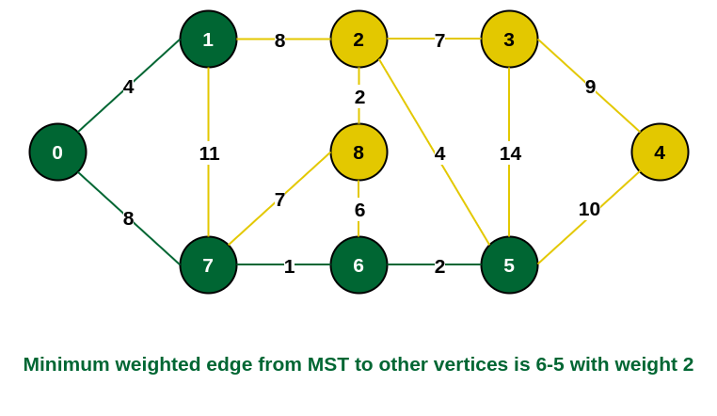
Prim’s Algorithm (Example conti..)
Step 5: The connecting edges now are {7, 8}, {1, 2}, {6, 8} and {6, 5}. Include
edge {6, 5} and vertex 5 in the MST as the edge has the minimum weight (i.e., 2)
among them

Slide 13
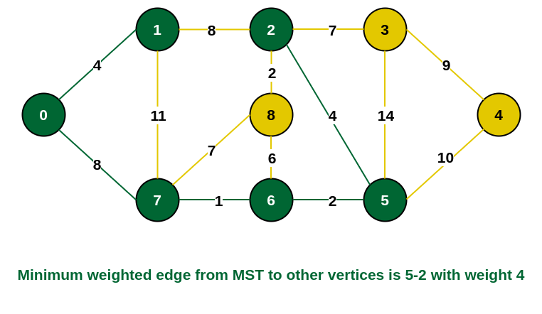
Prim’s Algorithm (Example conti..)
Step 6: Among the current connecting edges, the edge {5, 2} has the minimum
weight. So include that edge and the vertex 2 in the MST.

Slide 14
Prim’s Algorithm (Example conti..)
Step 7: The connecting edges between the incomplete MST and the other edges are
{2, 8}, {2, 3}, {5, 3} and {5, 4}. The edge with minimum weight is edge {2, 8}
which has weight 2. So include this edge and the vertex 8 in the MST.

Slide 15
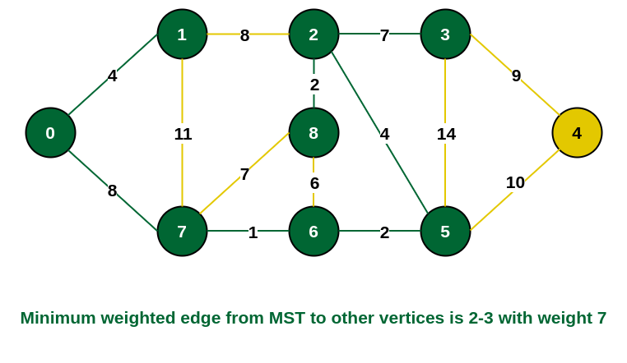
Prim’s Algorithm (Example conti..)
Step 8: See here that the edges {7, 8} and {2, 3} both have same weight which are
minimum. But 7 is already part of MST. So we will consider the edge {2, 3} and
include that edge and vertex 3 in the MST.

Slide 16
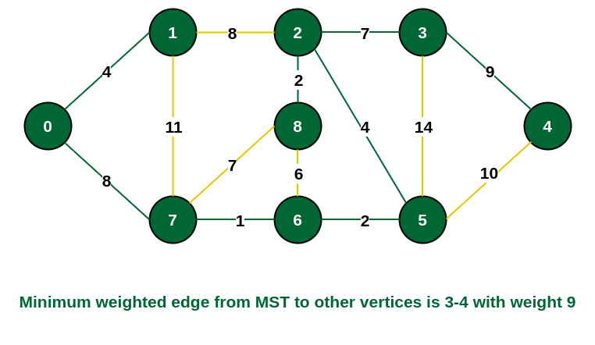
Prim’s Algorithm (Example conti..)
Step 9: Only the vertex 4 remains to be included. The minimum weighted edge from the incomplete MST to 4 is {3, 4}.

Slide 17
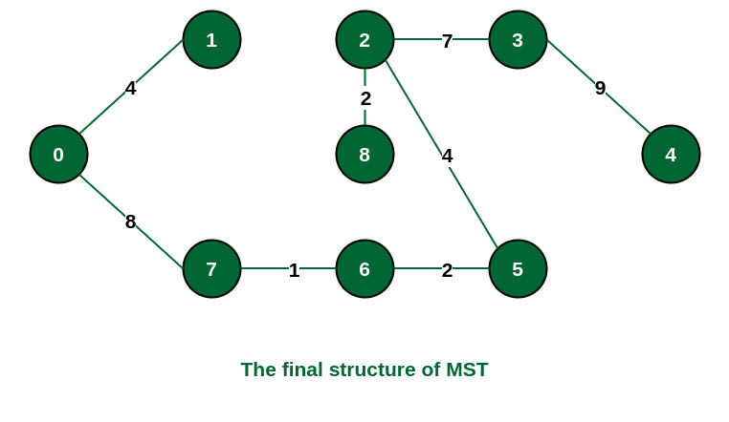
Prim’s Algorithm (Example conti..)
The final structure of the MST is as follows and the weight of the edges of the MST
is (4 + 8 + 1 + 2 + 4 + 2 + 7 + 9) = 37.

Slide 18
SUMMARY
Prim's technique works on the simple principle that all vertices in a spanning tree must be connected. To build a Spanning Tree, the two distinct subsets of vertices should be joined and they must be connected in such a way that summation of all edge weights is minimum.

Slide 19
SELF-ASSESSMENT QUESTIONS
Prim’s algorithm is a ______
Divide and conquer algorithm
Greedy algorithm
Dynamic Programming
Approximation algorithm
2. Prim’s algorithm can be efficiently implemented using _____ for graphs with greater density.
d-ary heap
linear search
fibonacci heap
binary search

Slide 20
TERMINAL QUESTIONS
1. Describe the minimum cost of a Spanning tree using Prim’s Algorithm?
2. List out the steps involved in Prim’s Algorithm?
3. Analyze the implementation details of minimum spanning tree using Prim’s Algorithm?
4. Summarize the concept of Prim’s Minimum Spanning Tree?

Slide 21
REFERENCES FOR FURTHER LEARNING OF THE SESSION
TEXTBOOKS:
1. Mark Allen Weiss, Data Structures and Algorithm Analysis in C, 2010, Second Edition, Pearson Education.
2. Allen B. Downey, ”Think Python: How to Think Like a Computer Scientist’’, 2nd edition, Updated for Python 3, Shroff/O’Reilly Publishers, 2016 (http://greenteapress.com/wp/thinkpython/)
3. Data Structures and algorithms using python, 2011,Rance D, Necaise, himilton printing
REFERENCE BOOKS:
1. Data Structures and Algorithm Analysis in PYTHON, 2010, Mark Allen Weiss, Second Edition, Pearson Education.
2. Data Structures and Algorithms, A.V.Aho, J.E.Hopcroft, and J.D.Ullman, Pearson Education, First Edition Reprint2003.
3. Advanced Guide to Python 3 Programming, John Hunt, 4th Edition, Springer Nature Switzerland AG 2019.
4. Python Basics: A Practice Introduction to Python 3, David Amos, Dan Bader, Joanna Jablonski, Fletcher Heisler, 4th edition, Real Python..
WEB REFERNCES/MOOCS:
1. https://docs.python.org/3/tutorial/datastructures.html
2. https://www.w3schools.com/dsa/dsa_intro.php
3. https://www.geeksforgeeks.org/python-data-structures/

Slide 22
THANK YOU
Team – Data Sructures through Python

